Slide 1
Ethernet IP Industrial Protocol
From http://www.odva.org
EtherNet/IP is an industrial networking standard that takes advantage of commercial off-the-shelf Ethernet communication chips and physical media. IP, stands for 'industrial protocol' and is what distinguishes this network. Unlike many options in the industrial Ethernet crowd, EtherNet/IP uses an open protocol at the application layer. Further, more than one vendor or organization backs EtherNet/IP. It is the only standard supported by three networking organizations: ControlNet International (CI), the Industrial Ethernet Association (IEA) and the Open DeviceNet Vendor Association (ODVA).

Slide 2
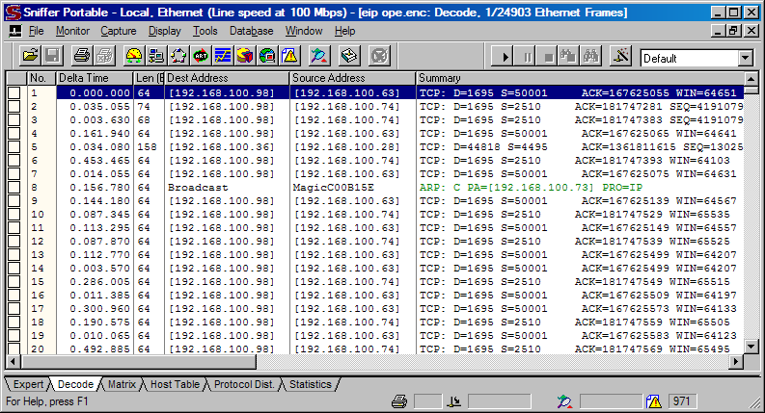
NAI Sniffer Pro v 4.70.553

Slide 3
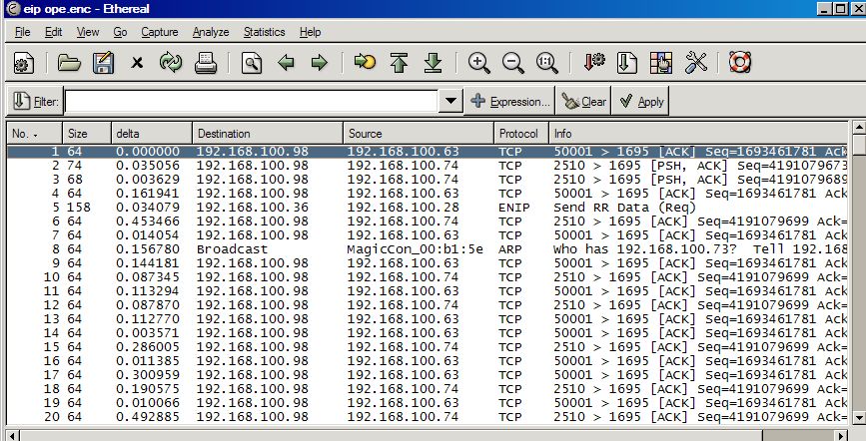
Ethereal v 0.10.6

Slide 4
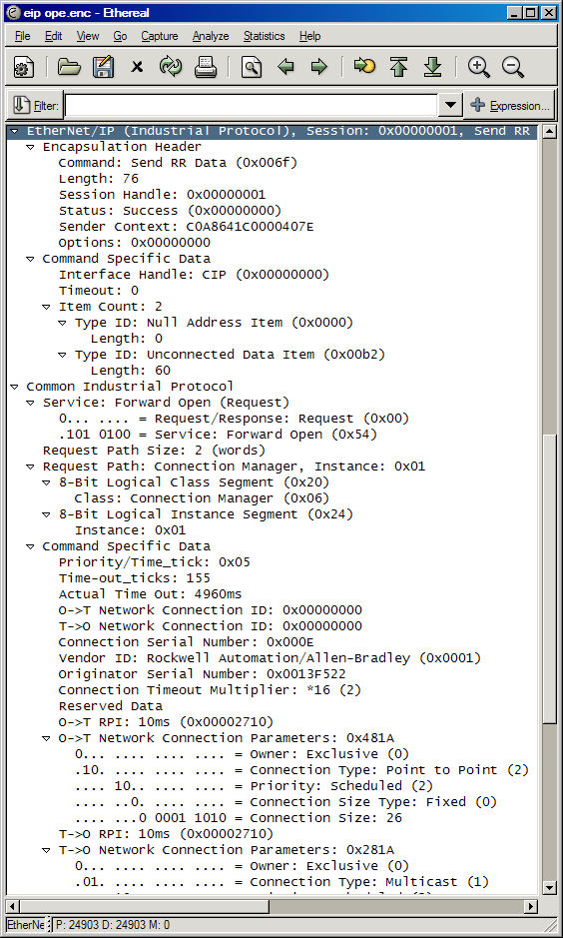
Ethereal v 0.10.6

Slide 5
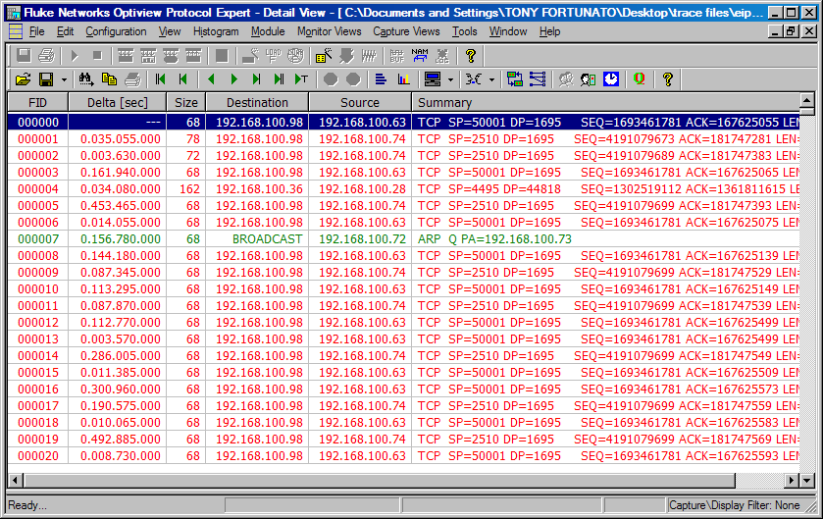
Fluke Optiview Protocol Expert v 6.1.0.13167.0

Slide 6
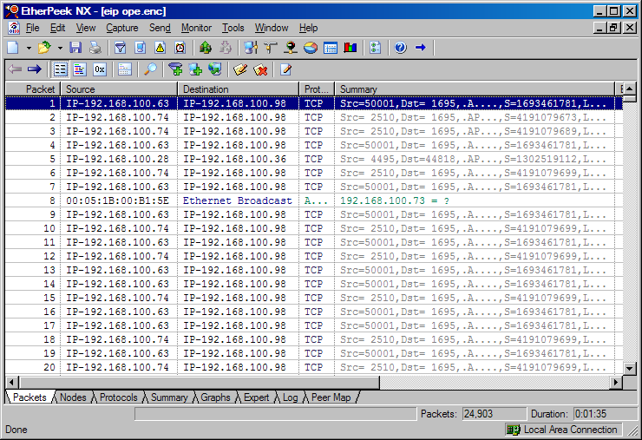
Wildpackets Etherpeek NX v 3.0.1

